Slide 1
Heuristics of Travelling Salesman Problem COD891
Presented by :
K Laxman
2018CS50408
Under Guidance of :
Prof. Keerti Choudary

Slide 2
Travelling salesman problem , complexity
Definition :
Given a set of Cities and the distance between each possible pair, the travelling salesman problem
Find
Best possible way of visiting all the cities exactly once and returning to the starting point,& complete the trip
- typically travelling salesman problem is weighted graph
An NP-Hard Problem !
TSP is NP-hard problem in combinatorial optimization studied in theoretical computer science
In many applications ,additional constraints such as limited resources or time windows make the problem considerably harder.
Application of TSP :
Purest form of tsp used for application such as planning, logistics , and the manufacture of microchips.
Slightly modified ,it appears as a sub problem in many areas such as DNA sequencing. Ex: DNA fragments, path for robots
Heuristics –To solve large problems ,Any advice that is often effective but is not always guaranteed to work.

Slide 3
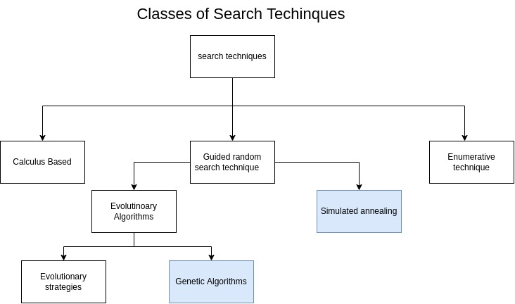

Slide 4
Simulated annealing is a probabilistic technique for approximating the global optimum of a given function. SA interprets slow cooling as a slow decrease in the probability of temporarily accepting worse solutions as it explores the solution space
Pseudo code
C = Cinit
For T = Tmax to Tmin
Ec = E(c)
N = next(c)
EN = E(N)
(ΔE) = EN – Ec
If (ΔE > 0)
C =N
else if (e ΔE/T > rand(0,1))
C= N
T= T* cooling_factor
repeat
Source :https://www.youtube.com/watch?v=eBmU1ONJ-os

Slide 5
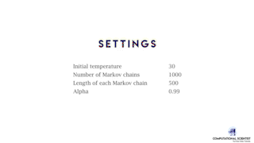
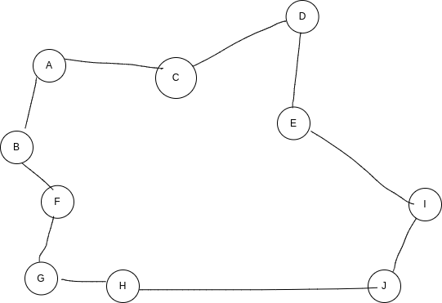
Simulated annealing
Example:
A->C->D->E->I->J->H->G->F->B->A
Source :https://www.youtube.com/watch?v=NPE3zncXA5s

Slide 6
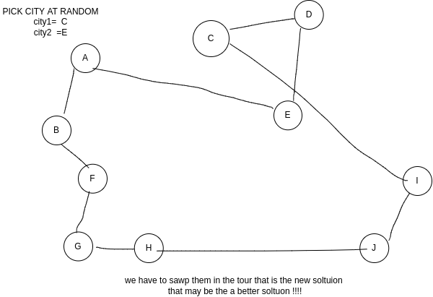
Simulated annealing
Source :https://www.youtube.com/watch?v=NPE3zncXA5s

Slide 7
Genetic algorithm: a search-based optimization technique based on the principles of Genetics and Natural Selection
PUSEDO CODE
START Generate the initial population Compute fitness REPEAT Selection Crossover Mutation Compute fitness UNTIL population has converged STOP
Genetic_algorithm(){
Population= generate_random_pop;
For (T in vulnerable paths)
Evaluate the population;
Generation=0
While (T not covered AND attempt < max_try) {
Selection= select(population)
Offspring = crossover(selection)
Population = mutate(offspring)
Generation = Generation+1
}
}
}

Slide 8
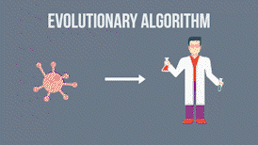
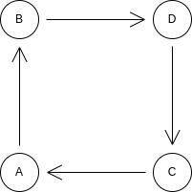
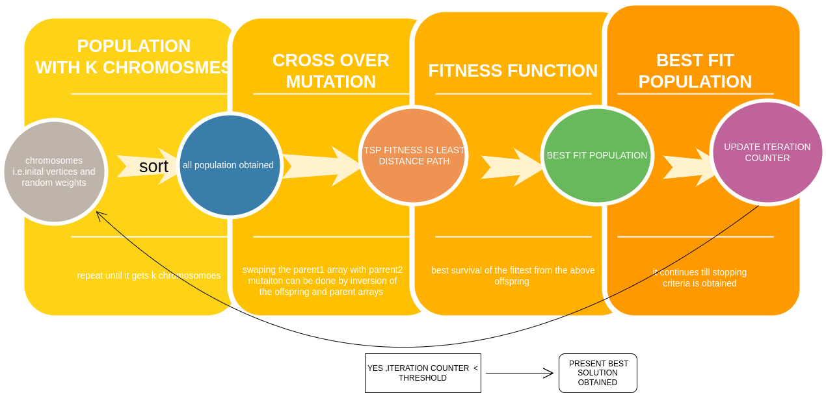
Genetic algorithm
Example
A->B->C->D->A
NO

Slide 9
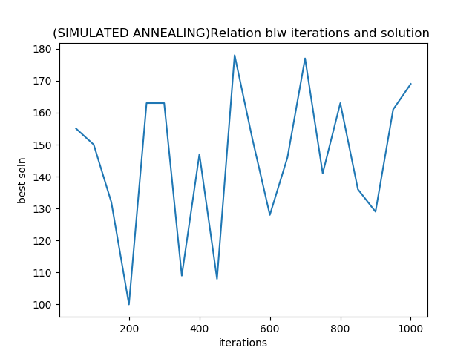
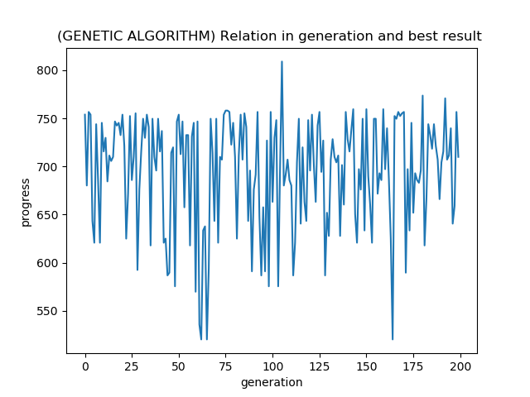
Comparative study b/w Simulated and Genetic :
Random graph

Slide 10
Key differences blw both
SIMULATED ALGORITHM GENETIC ALGORITHM
Inspired from metallurgy * borrowed from evolutionary biology
Single state method * population of possible solutions
accepting a candidate solution worse than * works based on survival of fittest idea
(i.e., uphill from) the current best solution
* Works best with continuous function requiring high accuracy * pure GA can only select one or two at any given position
Works better at solving mazes bcz they are
less likely to get suck in a local minima due to
their probabilistic "mutation" method.
*better at training neural networks, bcz of their genetically inspired training . This make more versatile and efficient in solving complex problems.

Slide 11
References :
https://en.wikipedia.org/wiki/Simulated_annealing
https://genome.sph.umich.edu/w/images/5/51/Bios615-fa12-lec20-presentation.pdf
https://www2.isye.gatech.edu/~yxie77/isye6416_17/Lecture13.pdf
https://codecapsule.com/2010/04/06/simulated-annealing-traveling-salesman/
https://ai.stackexchange.com/questions/9479/when-should-i-use-simulated-annealing-as-opposed-to-a-genetic-algorithm

Slide 12
THANK YOU

